Slide 1
Bloch Waves in periodic media
Pierre Margerit, May 2024

Slide 2
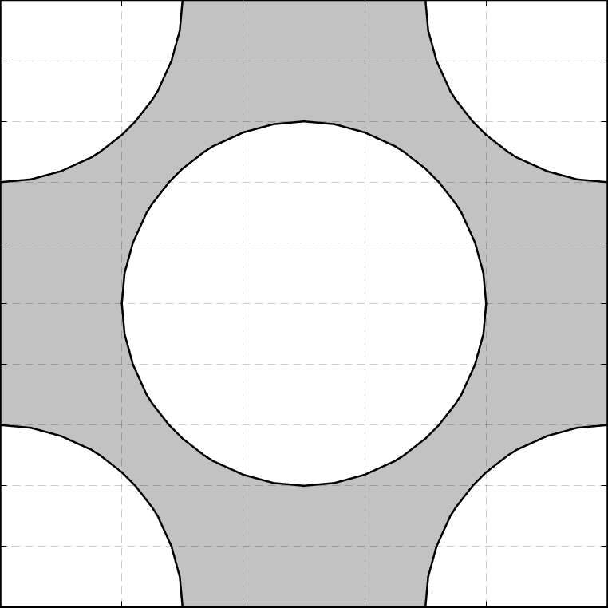
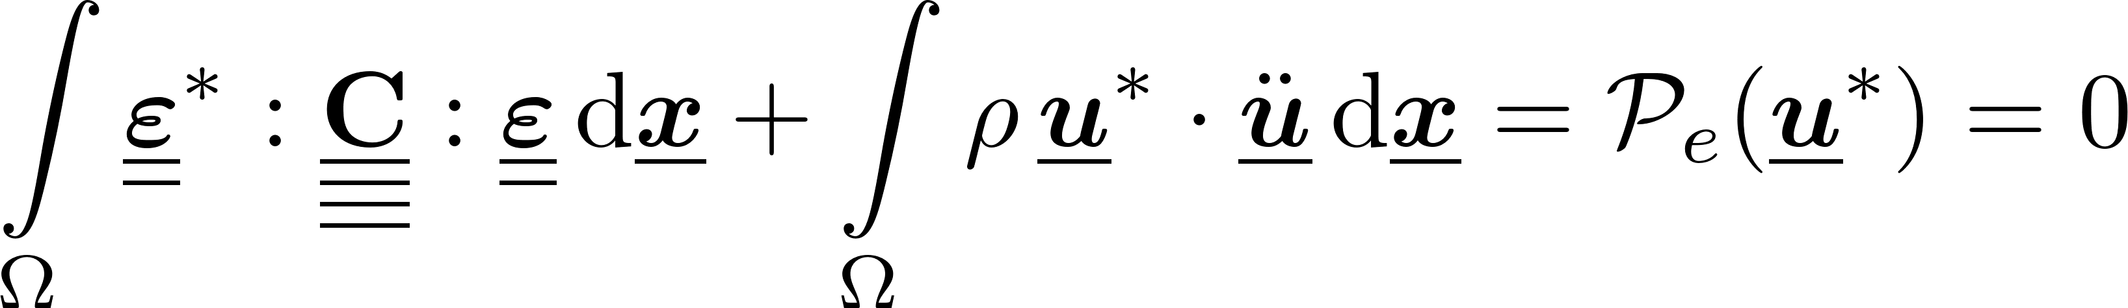

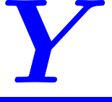
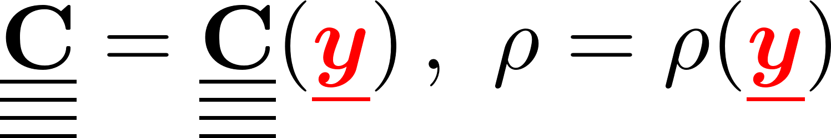
Two-scale media: variable separation
Governing equations of motion
Scale separation:
Microscopic unit cell:
Macroscopic grid:
Material properties:
Separed equations:
Free motion

Slide 3
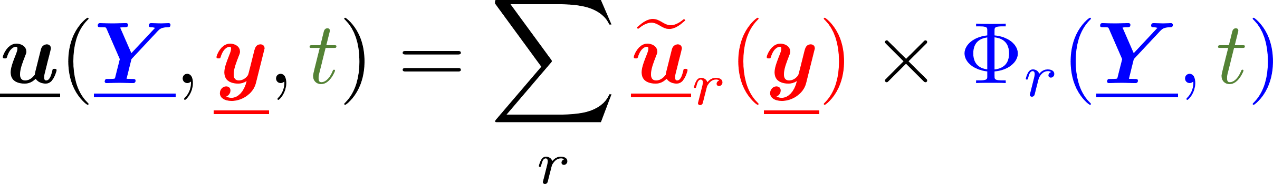
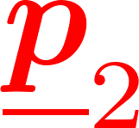
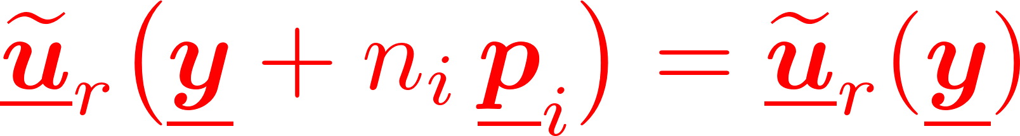

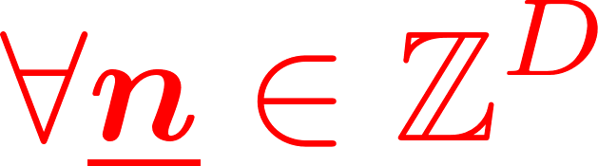

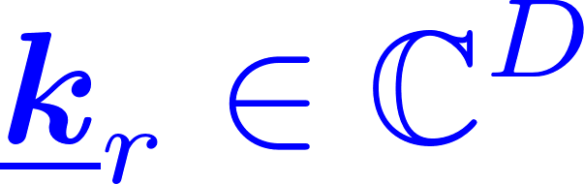
Two-scale media: separed solutions
Assuming separable solutions
Periodicity of the corrector: guarantees the C⁰-continuity
Elementary solutions: macroscopic plane wave
microscopic corrector
macro
time
micro
macroscopic modulation
periodicity vectors
‘‘Bloch Waves’’
pulsation
wavenumber

Slide 4

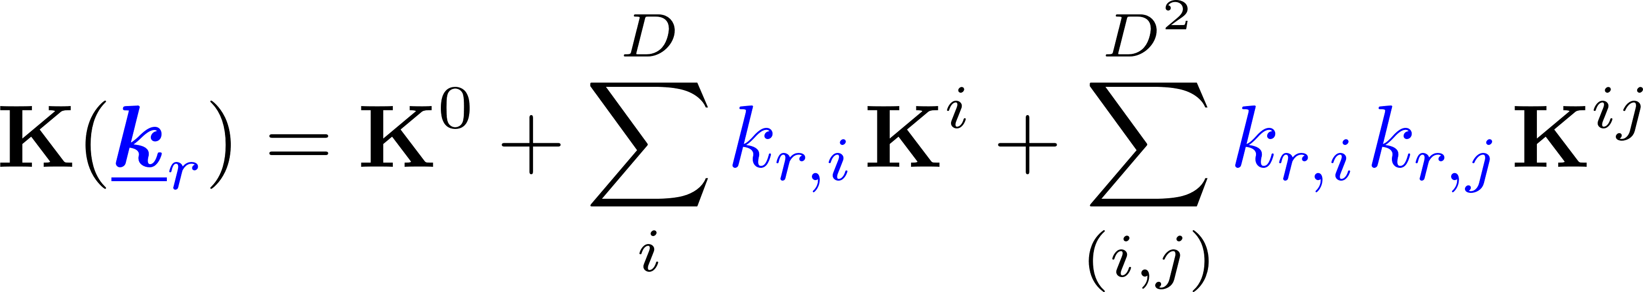
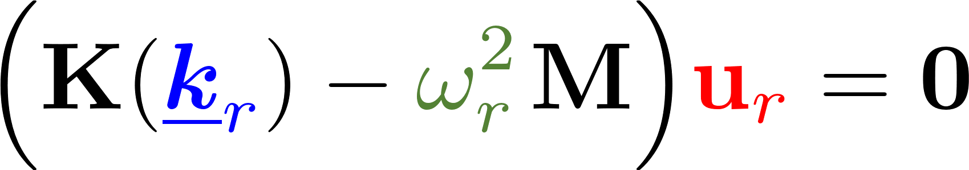
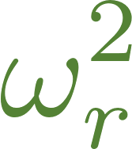
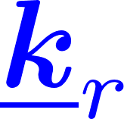
Bloch Wave Analysis
Separed gradient
Unit-cell local equations:
With a given discretization
The spectrum of Bloch Waves associated to a specific unit cell corresponds to the solutions of a Generalized Eigenvalue Problem in parametrized by
where

Slide 5
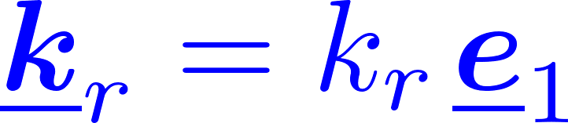
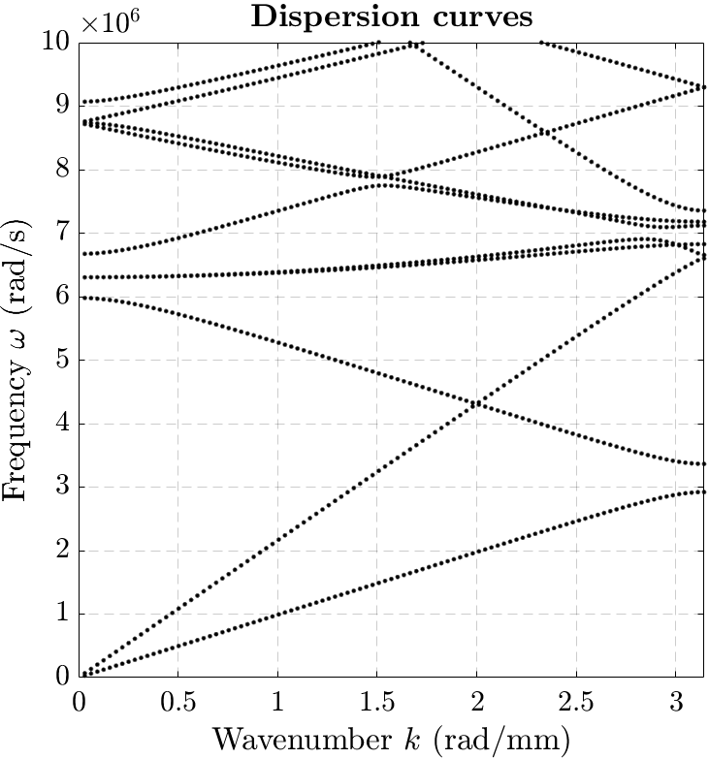

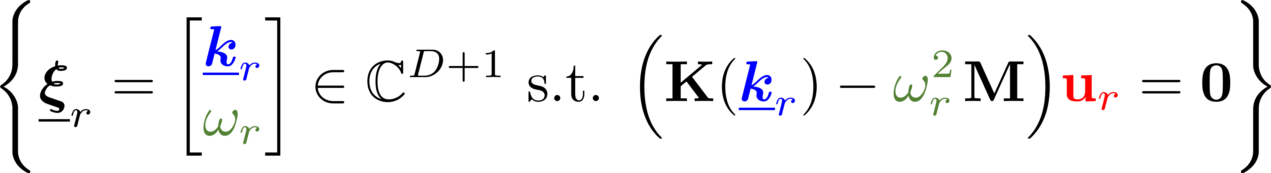
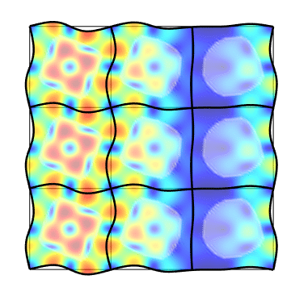
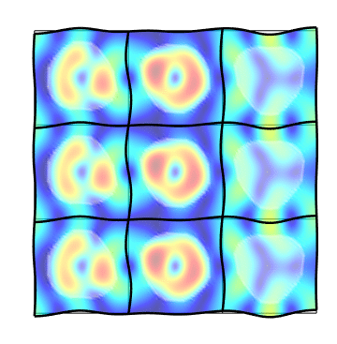
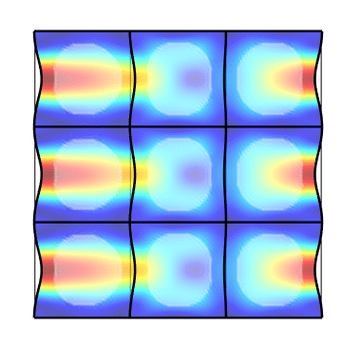
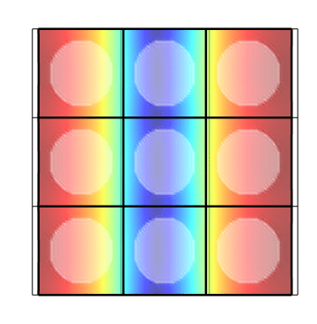
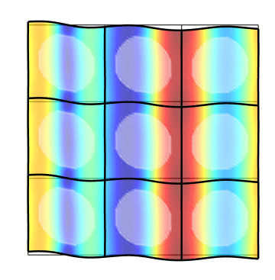
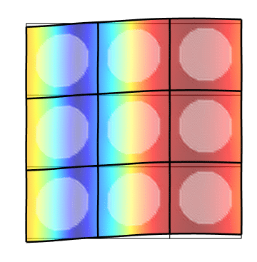
Bloch Wave Spectrum
Dispersion curves (or hypersurfaces)
In practice:
Define the unit cell (phase properties & distribution)
Build the sytem matrices K0, K1, K2, M
For kr in [kmin … kmax] extract the R smallest eigenvalues omegar
High computing cost !
Looks like low-order curves…

Slide 6
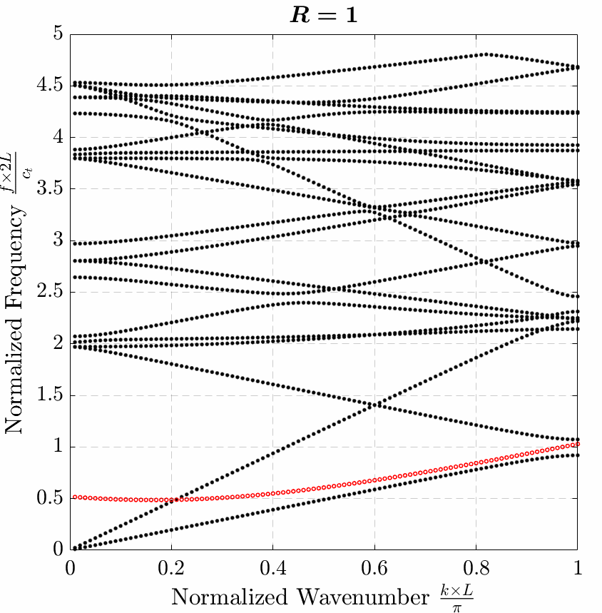
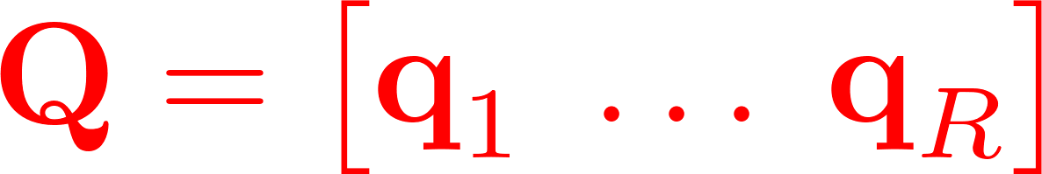
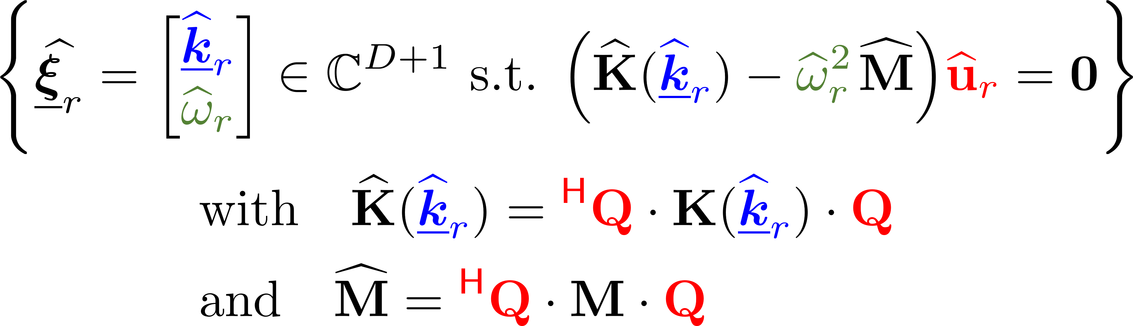
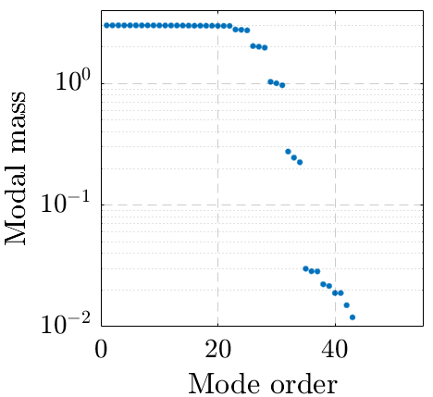
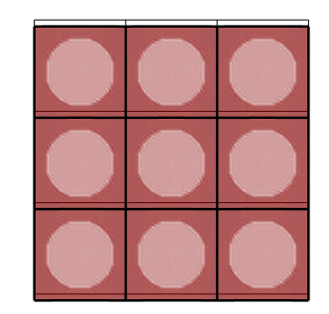
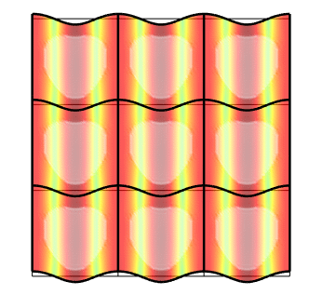
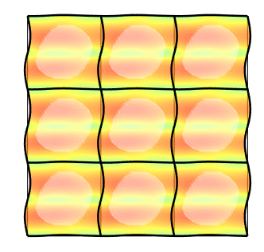
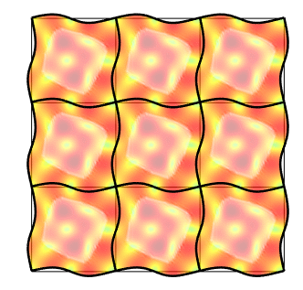
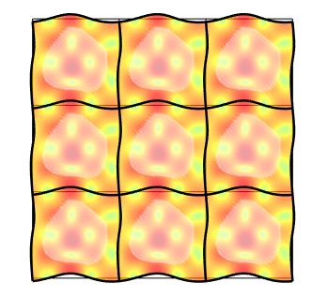
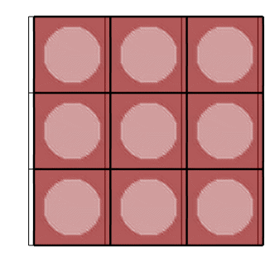
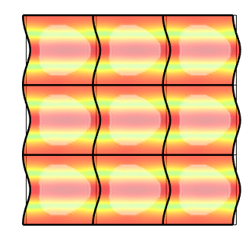
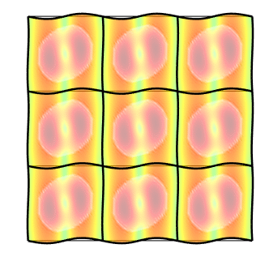
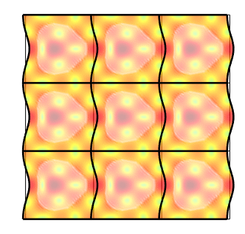
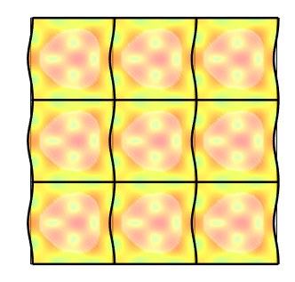
Model Order Reduction
Find a small basis of vectors such that
approximates well the dispersion curves
Coarsening approach :
compute for a coarse set of wavenumbers
keep only the R most significant (M-norm) eigenvectors

Slide 7
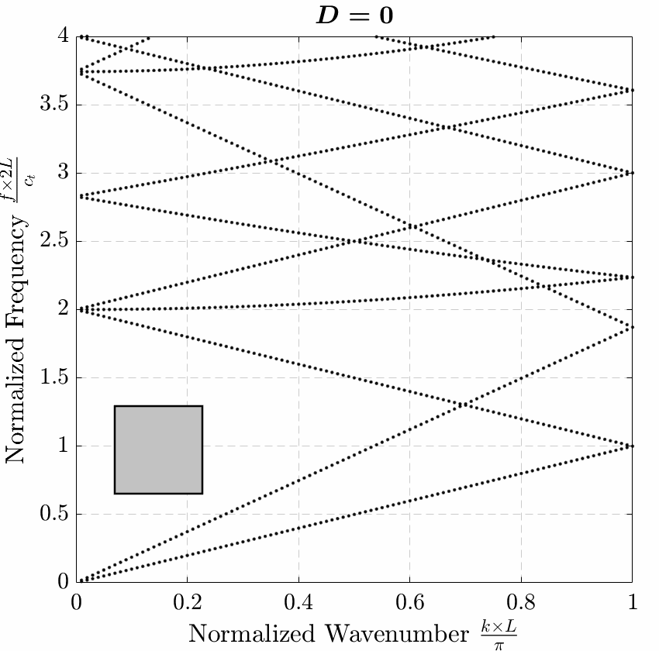
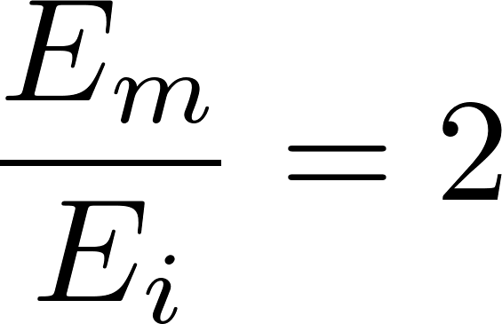
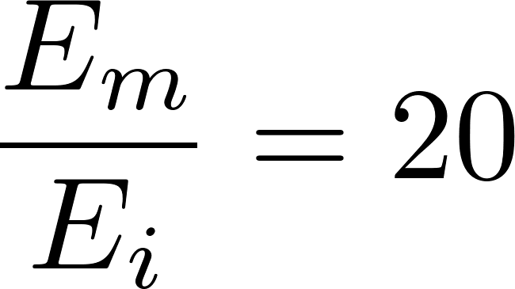
Diameter of the inclusion

Slide 8

Shape of the inclusion

Slide 9
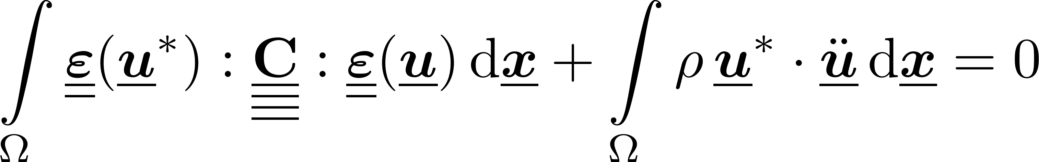
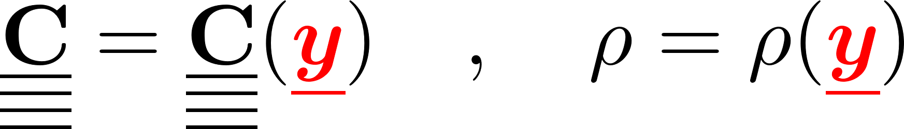
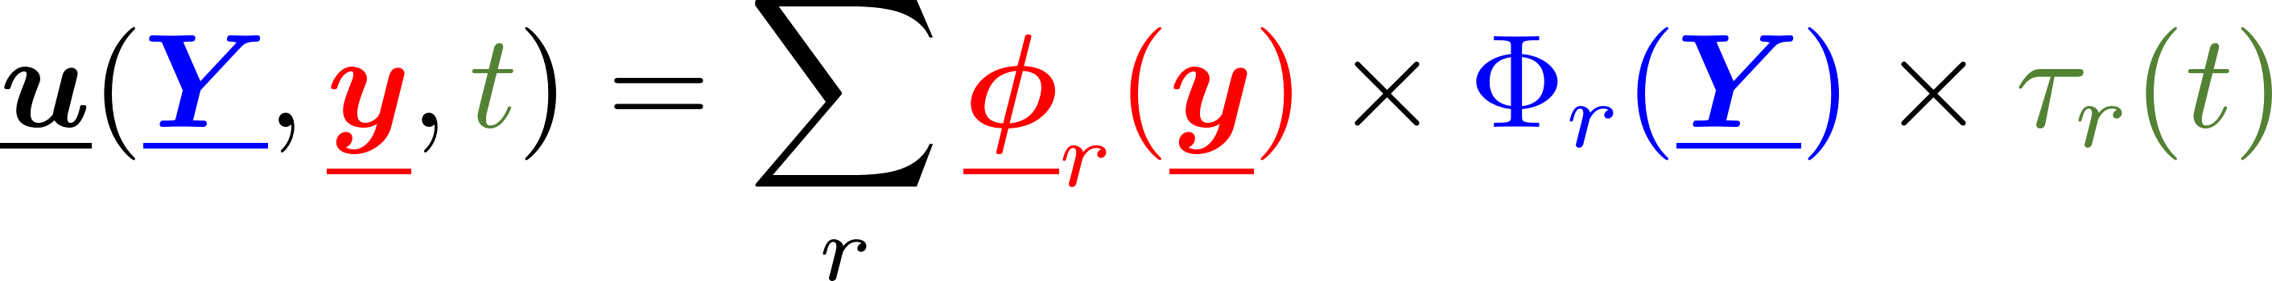
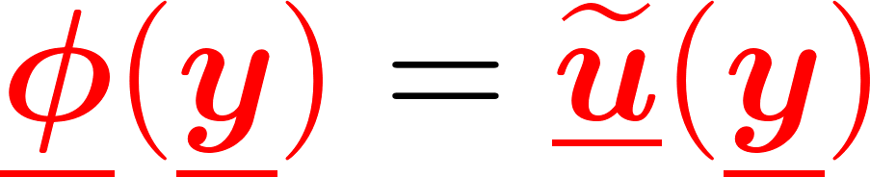
Two-scale media
Governing equations of motion
Scale separation: unit cell / macroscopic grid
Assuming a separable solution
Bloch Wave Basis
Macroscopic plane wave
Microscopic corrector
Gradient
macro
time
micro
pulsation
wavenumber

Slide 10
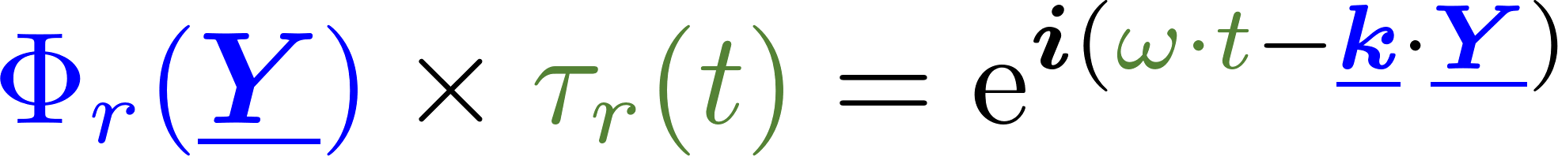
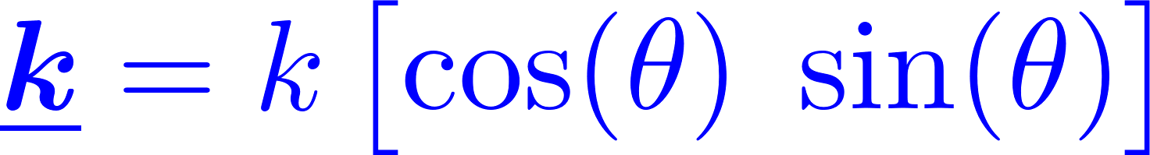
Bloch-Floquet analysis
Scale separation:
Bloch Wave basis:
Macroscopic plane wave
Microscopic corrector / wave polarization
Gradient :
Problème aux valeurs propres :
macro
micro
k modèle
pulsation
wavenumber

Slide 11
Bloch-Floquet analysis
Governing equations of motion
Scale separation: unit cell / macroscopic grid
Assuming a separable solution
Bloch Wave Basis
Macroscopic plane wave
Microscopic corrector
Gradient
Polynomial Eigenvalue Problem
macro
time
micro
pulsation
wavenumber

